Slide 1

Mongo Database
MongoDB

Slide 2
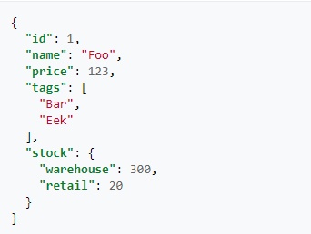
JSON

Slide 3
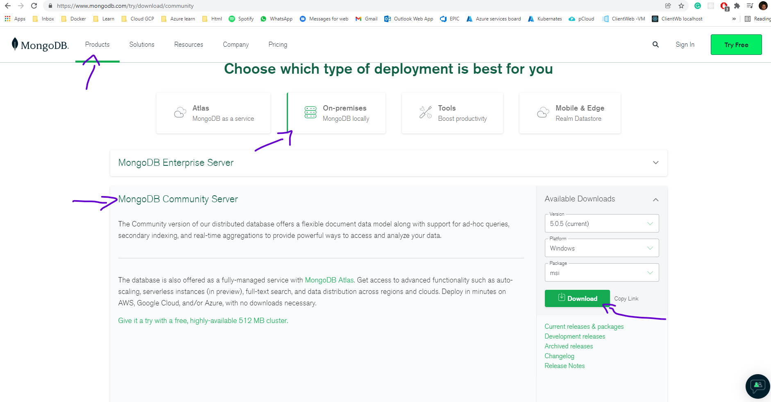
Install MongoDB

Slide 4
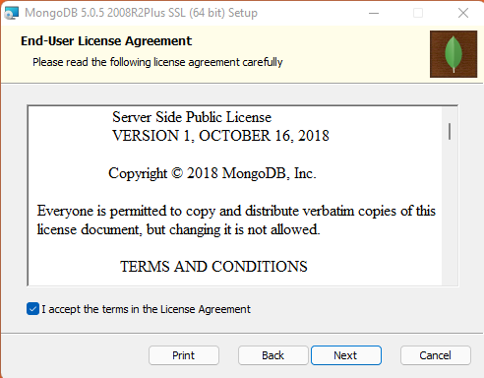
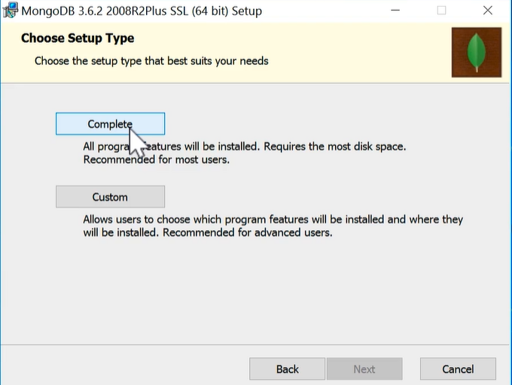
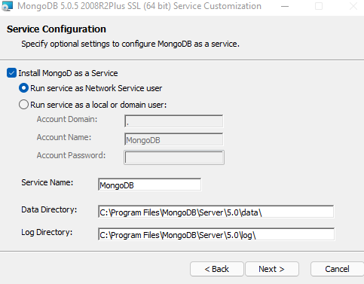
Installing MongoDb

Slide 5
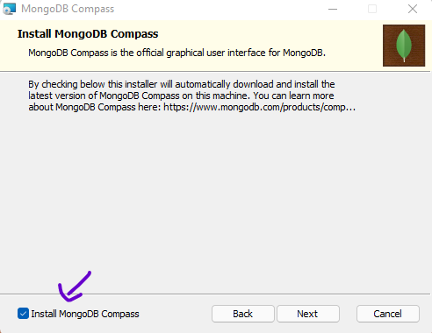
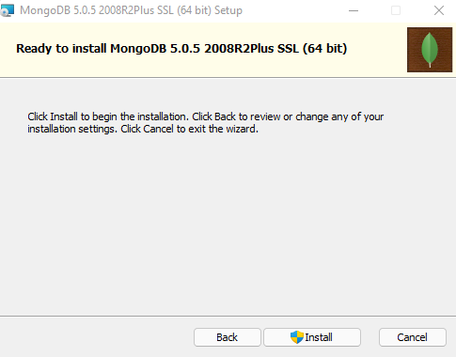
Installing MongoDB

Slide 6
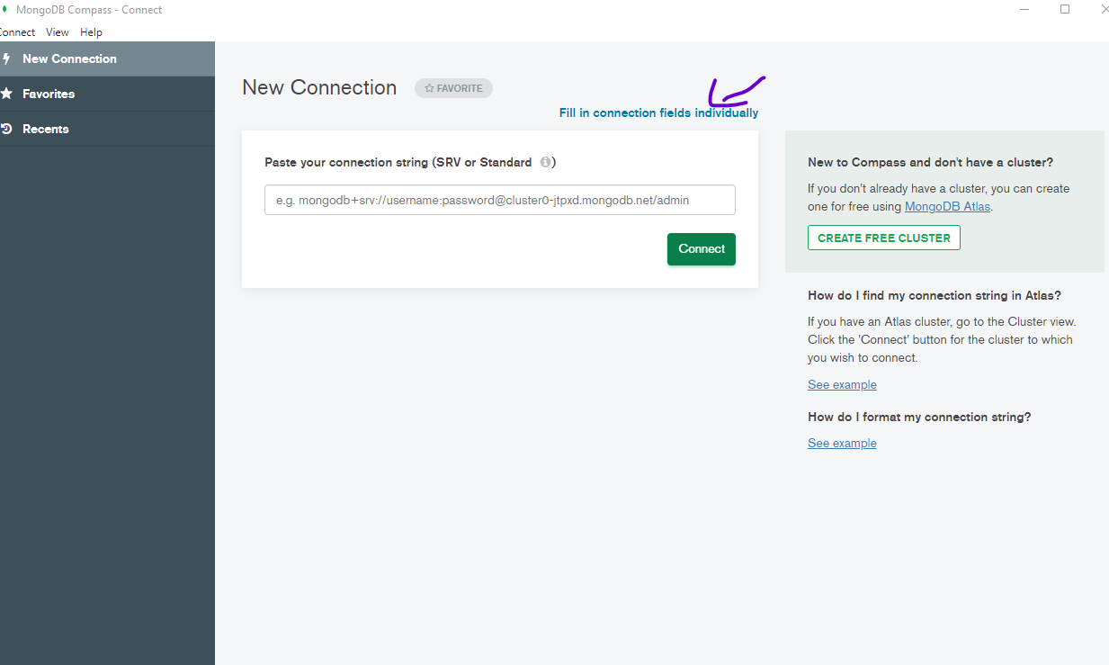
Click on fill in connection

Slide 7
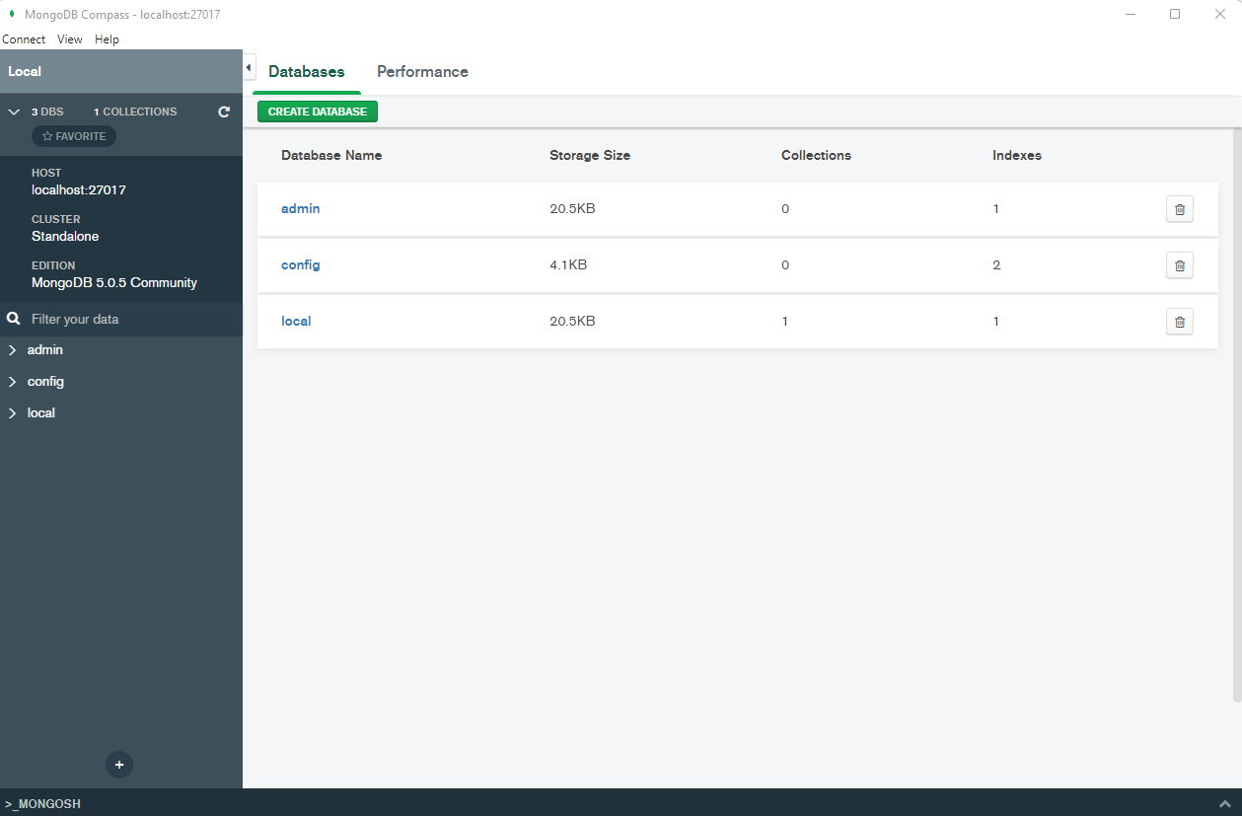
Connected to MongoDB

Slide 8
What is MongoDB ?
MongoDB it is database solution.
The name come from Humongous – because it can store lots and lots of data! AND u can work wit it efficiently which of course also is super important.

Slide 9
No-SQL vs SQL
Collections vs Tables
Documents vs Rows
JSON!!!

Slide 10
Shop DB
In our database there is
Two collections Users and
Orders.
In each collection there
Is several documents
Database
Users
Orders
Collections
{name:’Elias’, age:31}
We store data in MongoDB in a JavaScript objects format
Documents
{name:Ronaldo’, age:33}

Slide 11
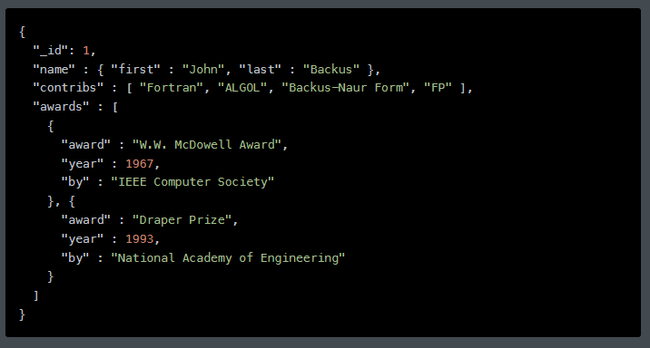
JSON Data format
Another cool feature of Mongo dB and its documents, u can
Store nested data in there and why is that helpful?
Well, this allows you to create complex
Relations between data and store then in one and the same document
Witch makes working with it and fetching
It super efficient,
Where in SQL, you must write complex joins to find data in table A and data in table B
Read more about JSON

Slide 12
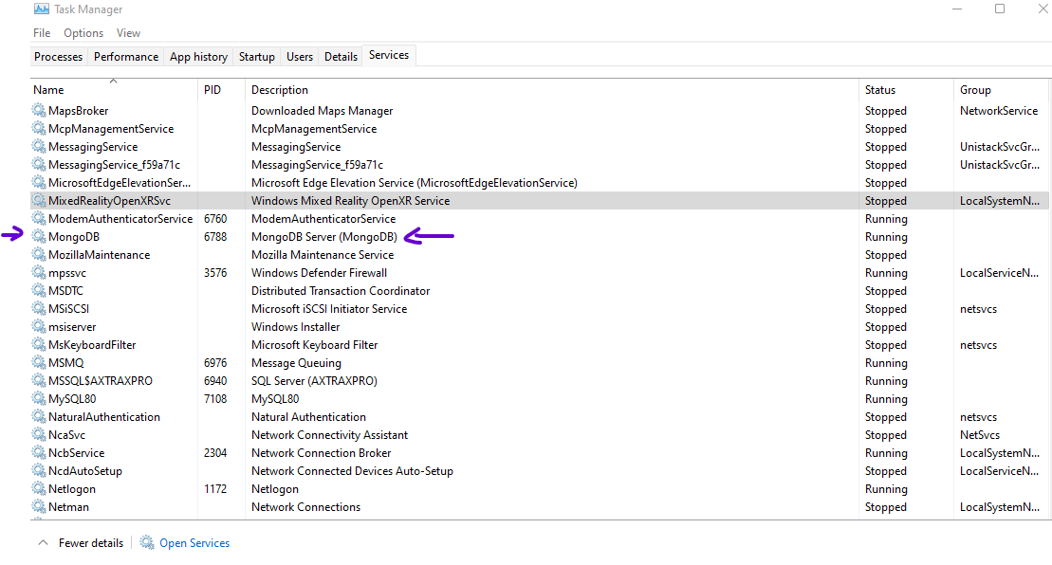
After u install MongoDB

Slide 13
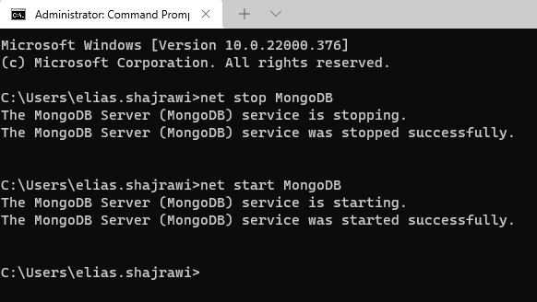
Stop and run MongoDB
Also u can do it from services

Slide 14
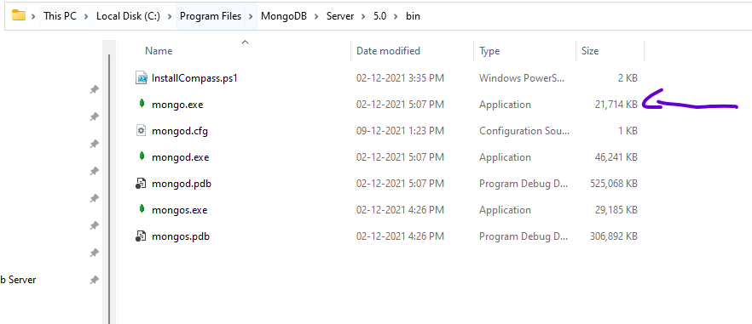
Run MongoDB client (shell)

Slide 15
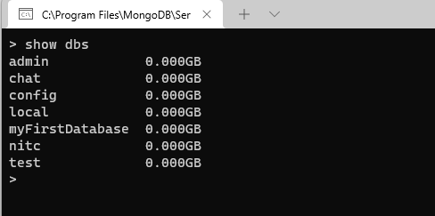
Shell
Via the Shell u can run commands to insert, get, update and delete data
Show dbs commands to list the currents dbs we have
Run shell mongo.exe from C:\Program Files\MongoDB\Server\5.0\bin

Slide 16
Some basic commands
show dbs → see the current databases
use [database name], example: use shopDB → to connect to database, if the DB not exist it will create it.
db.products.insertOne({name:”max”}) → Insert new value, if collection is not exist will be created automatically, in this example products is the new collection.

Slide 17
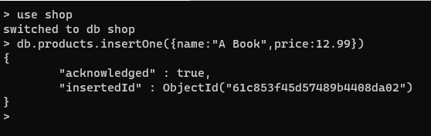
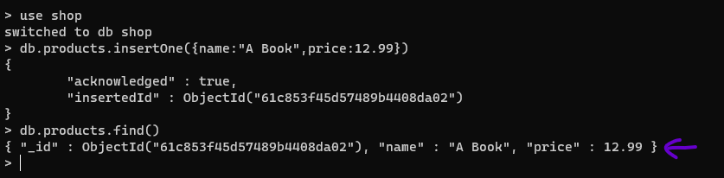
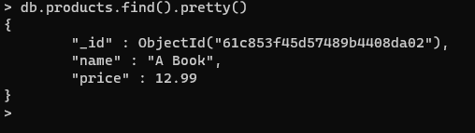
Insert command
Insert of new object to collection
List all the objects in
collection by using find()
List of all the objects in a collection using find and pretty

Slide 18
Exercise
Create new collection products
Add new product T-Shirt with price
Show all the products that already have in the database

Slide 19
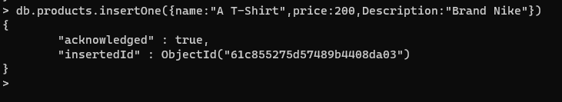
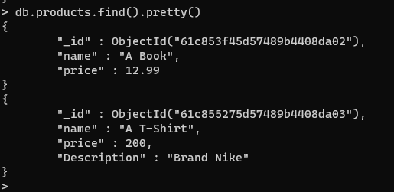
Solution
Add new product
Show all the products

Slide 20
Why we are using the SHELL
Because want to teach you something which you can apply to all use cases and that is the case with the SEHLL.
Of course, in the end you will build an application with programming language C#

Slide 21
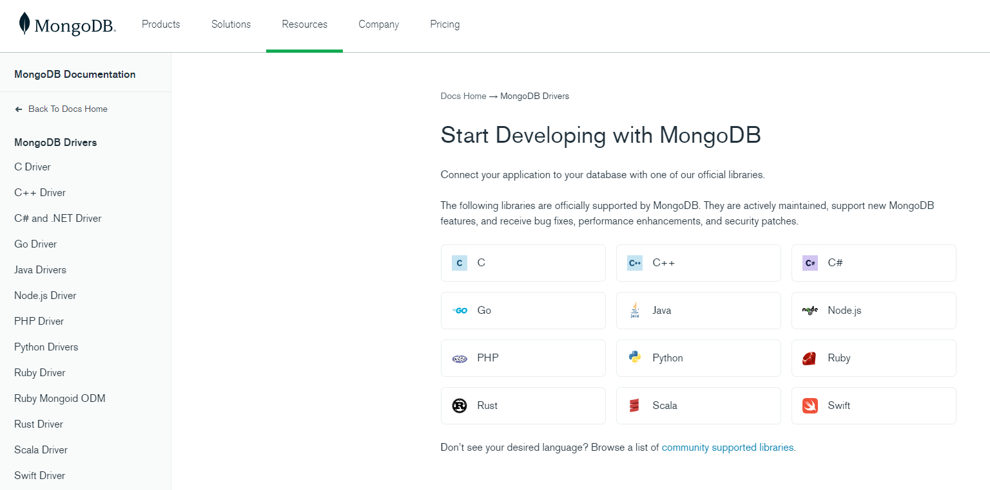
MongoDB Drivers
Link to Drivers
In there drivers, you use the same commands as we use in the shell,
just adjusted to the syntax of the language you are working with

Slide 22
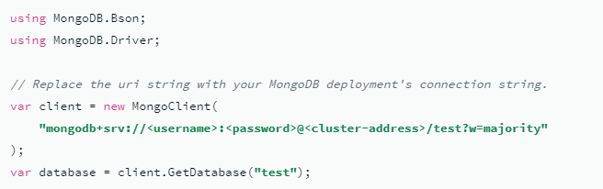
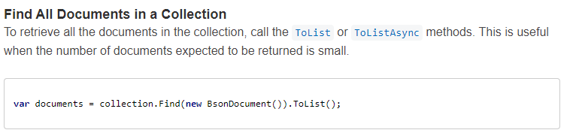
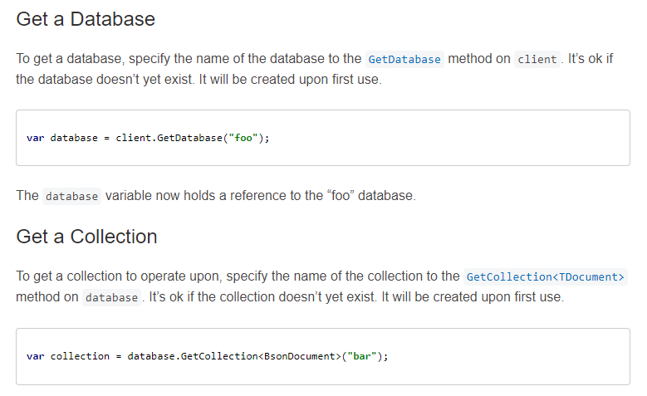
Mongo Drivers Examples
To read more about C# drivers,
documentations and examples

Slide 23
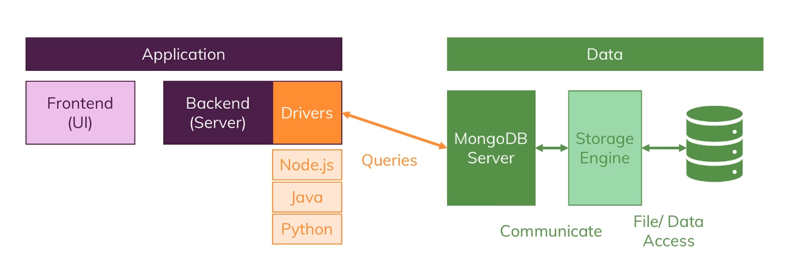
MongoDB high level design

